Slide 1

SENIOR DESIGN PRESENTATION
Reese Rapin, Neha Annareddy, Minha Raza, Ayush Sunkad, Vaishakh Nair

Slide 2
Names
Faculty Advisor
Jillian Aurisano
Team Members
Reese Rapin: rapinre@mail.uc.edu (513) 331-1466
Neha Annareddy: annarenr@mail.uc.edu (513) 836-5032​
Minha Raza: razamh@mail.uc.edu (502) 619-4362
Ayush Sunkad: sunkadah@mail.uc.edu (614) 717-3148
Vaishakh Nair: vibudhvh@mail.uc.edu (513) 837-0735

Slide 3
PROJECT ABSTRACT
We plan on creating a working web application platform with a connected front and back end. We plan to create a pet social media for foster animals so past foster parents can check up on pets they had been connected with prior. More specifically, we will aim to create a sort of tree like chart that follows a pet home to home, but also a hereditary chart to help create a extensive health profile for an animal. We also plan on creating a space for users to follow each other, connect with ethical breeders, have a system to ensure there is a lower chance of scams within pet trading and commerce. Moreover, we would like to learn more about possible security implementations to verify a user or seller. All in all, we are trying to connect pets with passionate pet lovers.

Slide 4
USER STORIES
As a foster parent, I would like to follow the pets I foster after they are adopted.​
As a person who adopts pets, I would like the pet’s existing account’s ownership transferred to me when I adopt the pet. I would also like to be able to share updates about the pet’s new life with the foster family.​
As a breeder, I want a mechanism to verify my identity and the pet I am selling so that I can build trust with potential adopters and avoid scams.​
As a person who adopts pets, I want to see the available animals with photos of them and profiles so that I can make an informed decision on my adoption.​
As an ethical breeder, I would like to display a family tree for my animals so potential buyers can see the pets' lineage.

Slide 5
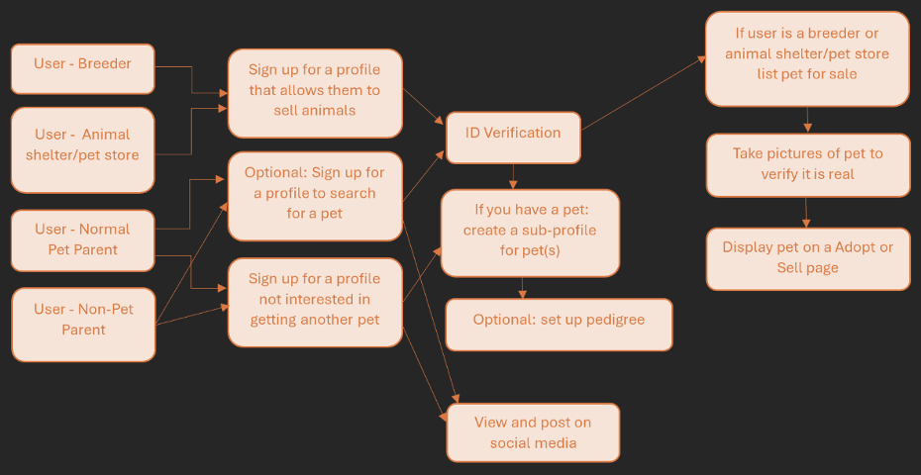
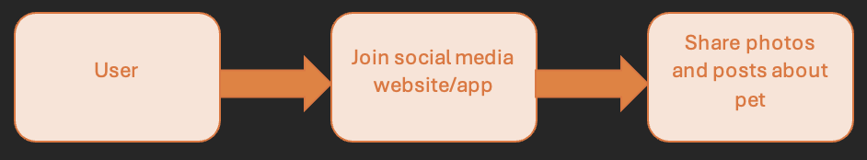
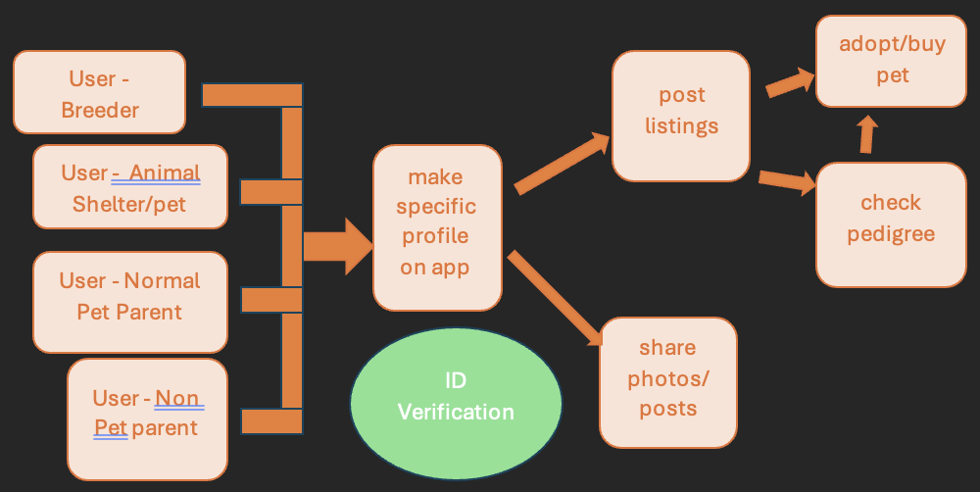
Design Diagrams
Design Level 1:
Design Level 2:
Design Level 3:

Slide 6
CURRENT STATE OF PROJECT
We are currently in the planning and researching stages
Importance of user interviews & research within the UI
Fine tuning a plan of action – ReactJS for frontend and Node.Js for backend
We are planning on finishing up our design documentation and starting to go from there.

Slide 7
EXPECTED ACCOMPLISHMENTS
Reese Rapin - She wants to learn and get more comfortable with backend development
Neha Annareddy -she wants to sharpen frontend design & learn figma skills
Minha Raza
-she wants to become more comfortable in reactjs & frontend development
Ayush Sunkad
-HE WANTS TO SHARPEN HIMSELF WITH THE FRONTEND AND FAMILIARIZE HIMSELF WITH THE BACKEND OF DEVELOPMENT
Vaishakh Nair

Slide 8
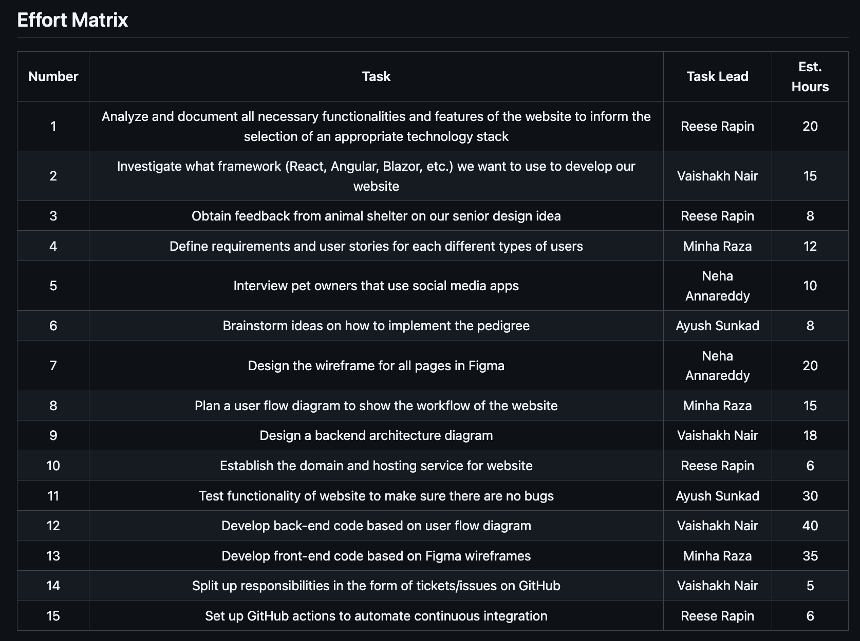
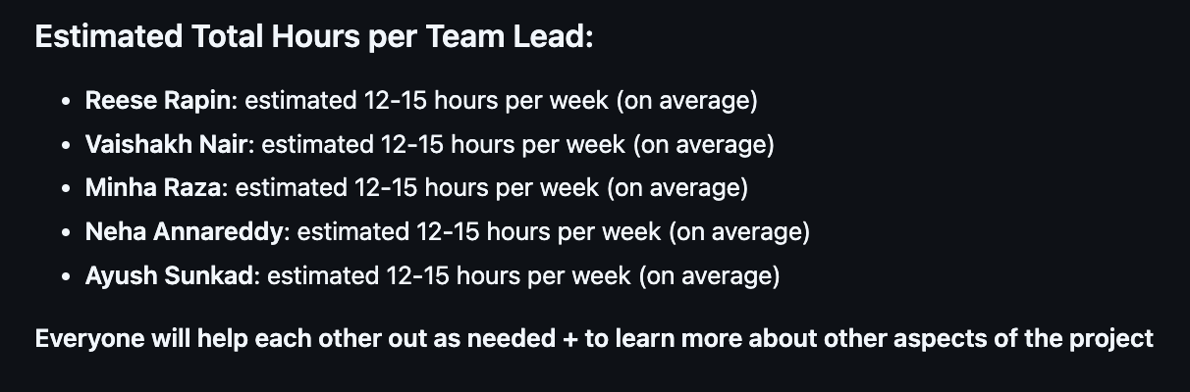
DIVISION OF WORk (ParT 1)

Slide 9
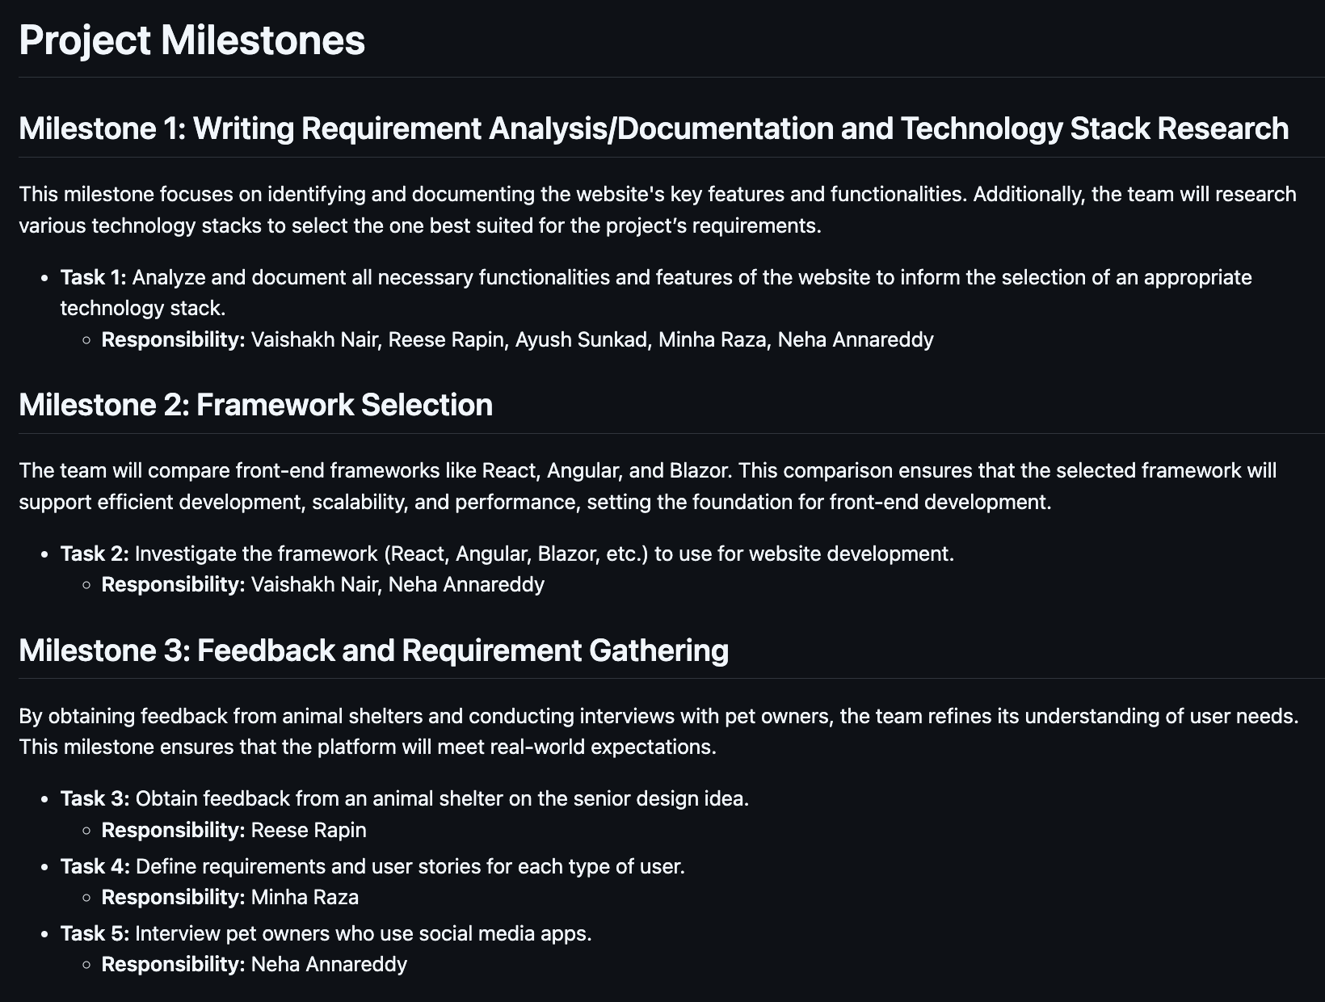
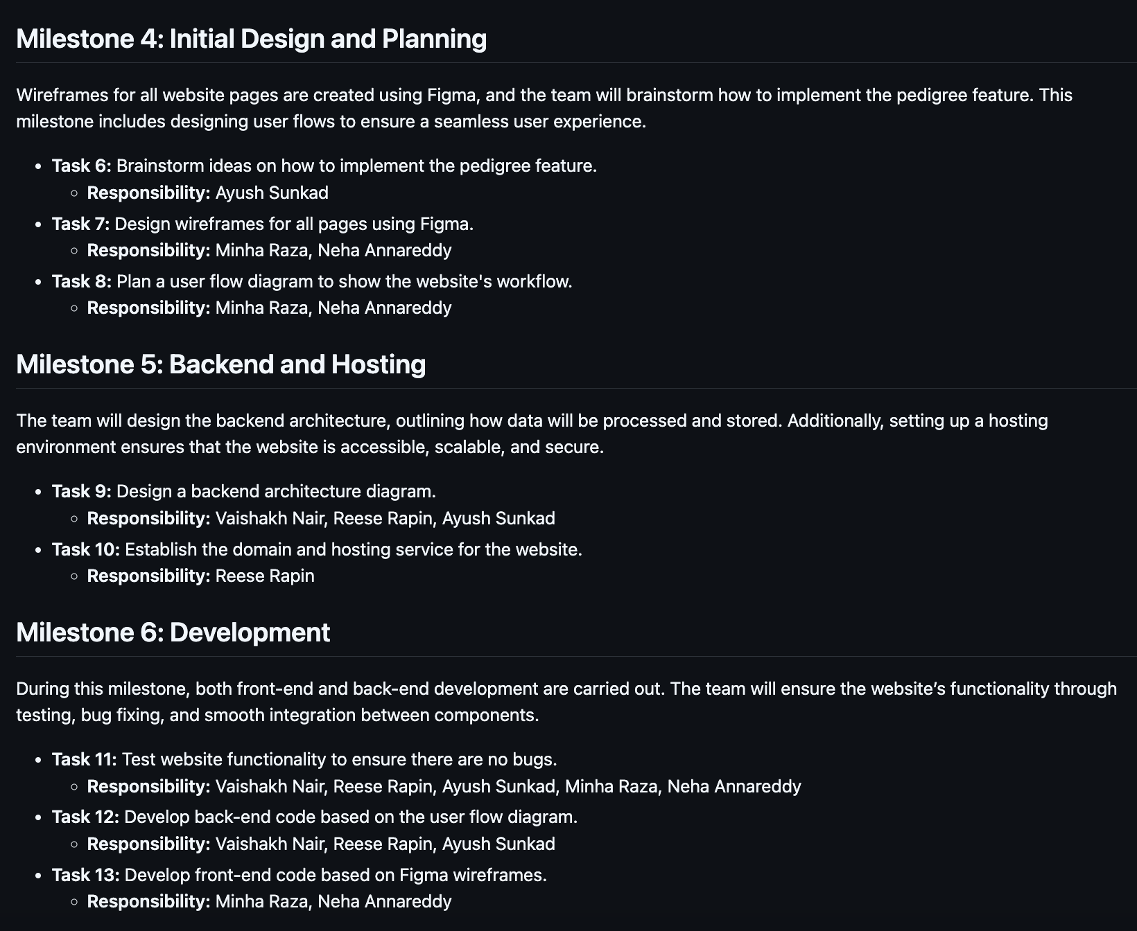
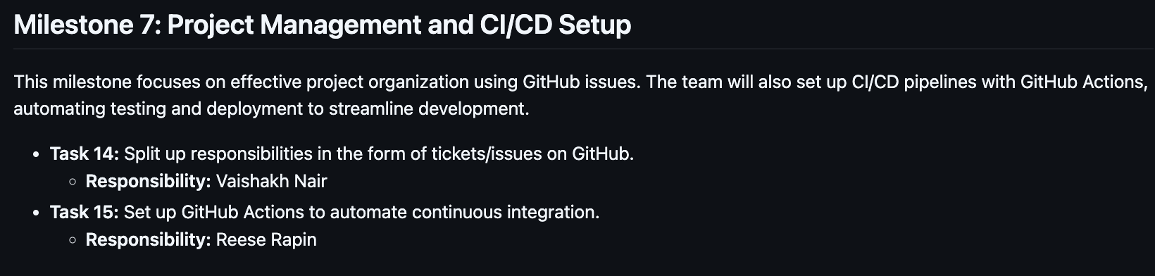
DIVISION OF WORk (ParT 2)

Slide 10
EXPECTED DEMO
We plan on doing a live demo to show case the working the development of the web application progress.

